Slide 1
Timbre
If you play the same note on a guitar and a piano with the same amplitude, what makes them sound different is timbre
Volume
Frequency

Slide 2
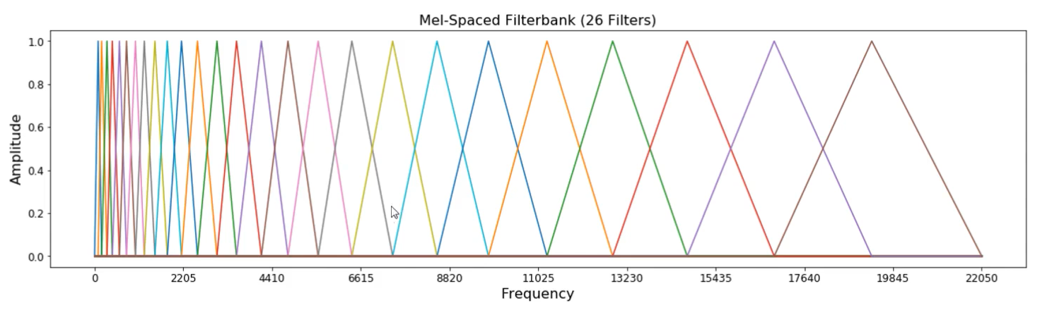
Finding features
Waveform
DFT
Log-Amplitude Spectrum
Mel-Scaling
Discrete Cosine
Transform
MFCC
Notes:
The advantage of MFCC is that they try to model the way we perceive frequency. The way we process audio
Originally for speech recognition.
Now used for genre classification and also instrument classification

Slide 3
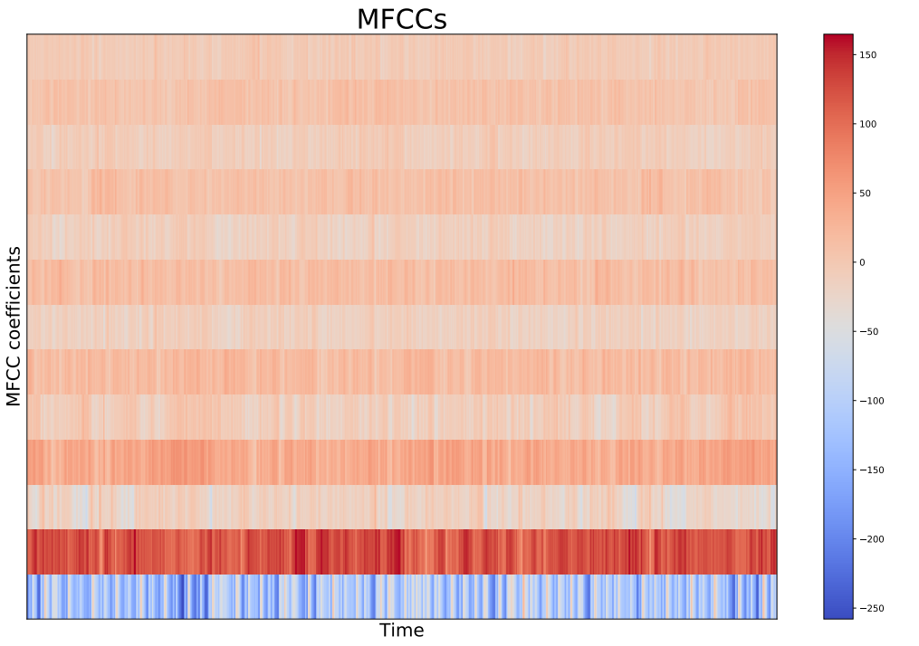
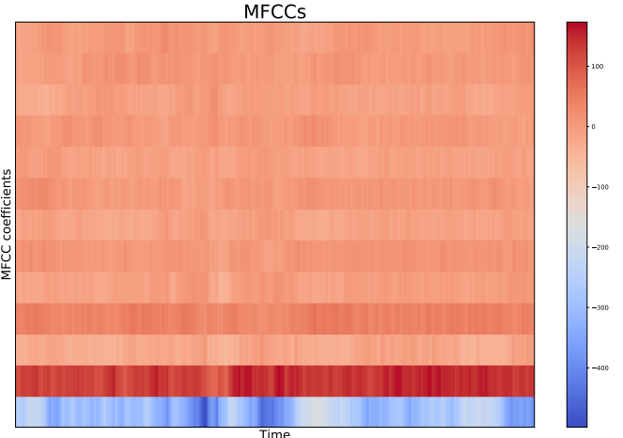
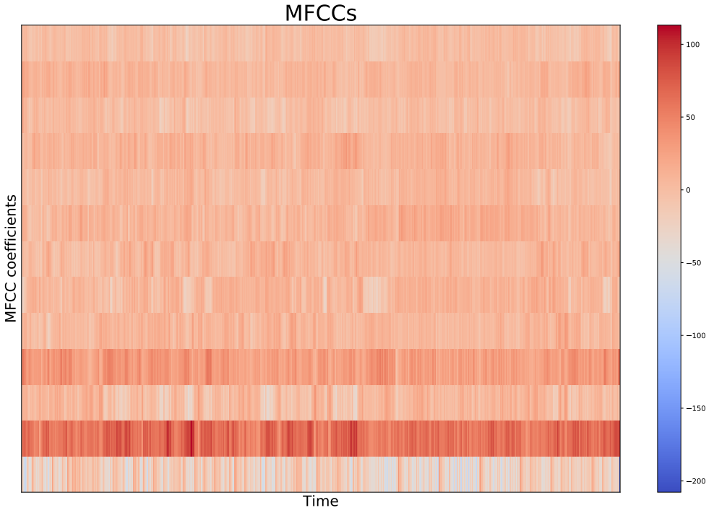
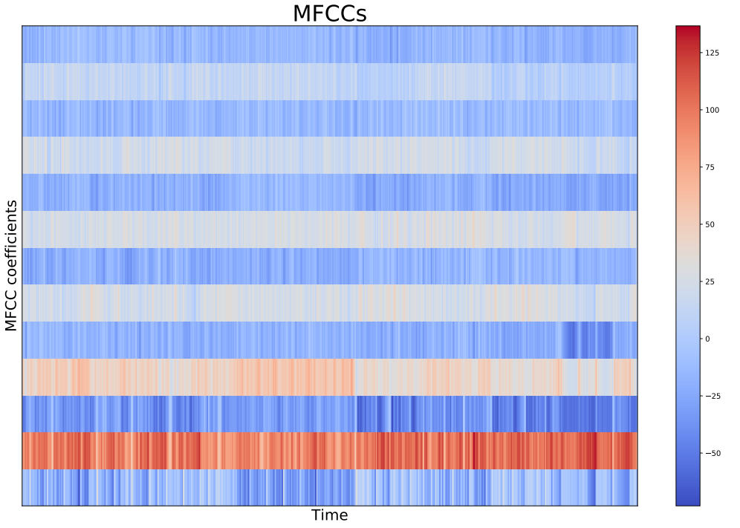
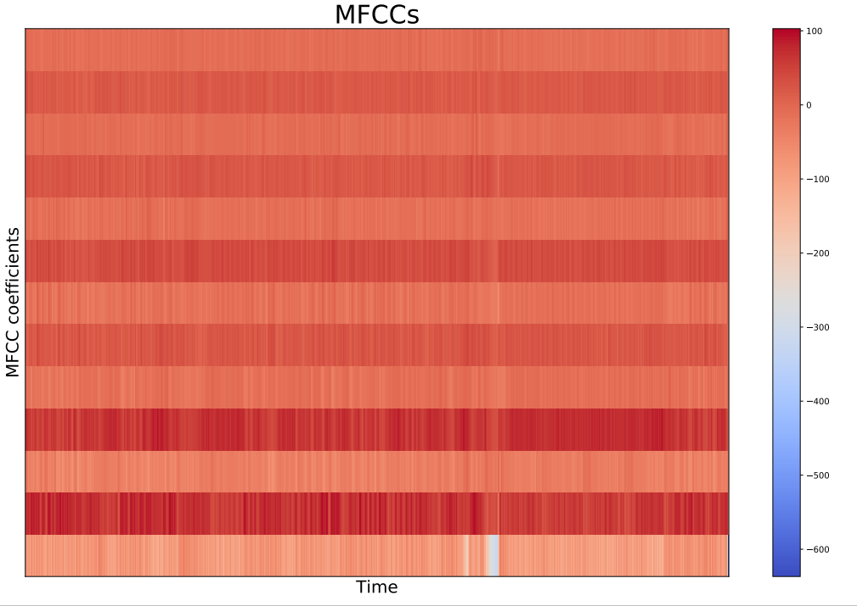
Example MFCCs
Blues
Classical
Country
Rock
Metal

Slide 4
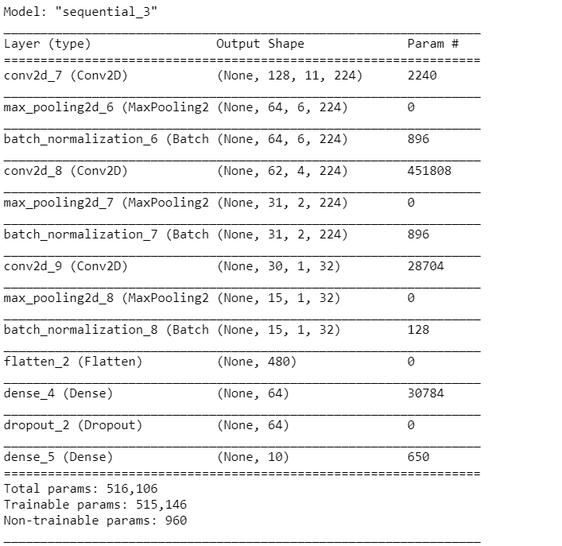
Conventional Neural Network
Used Keras.Sequential to build CNN
3 x Convolution layer, max pooling, batch normalization
1 Dense layer with 64 neurons
Dropout layer
Dense layer with 10 neurons
30 epochs used
Takes roughly 30 minutes to train
Optimized using Keras.Tuner “RandomSearch”
number of convolution layers
number of filters in each layer

Slide 5
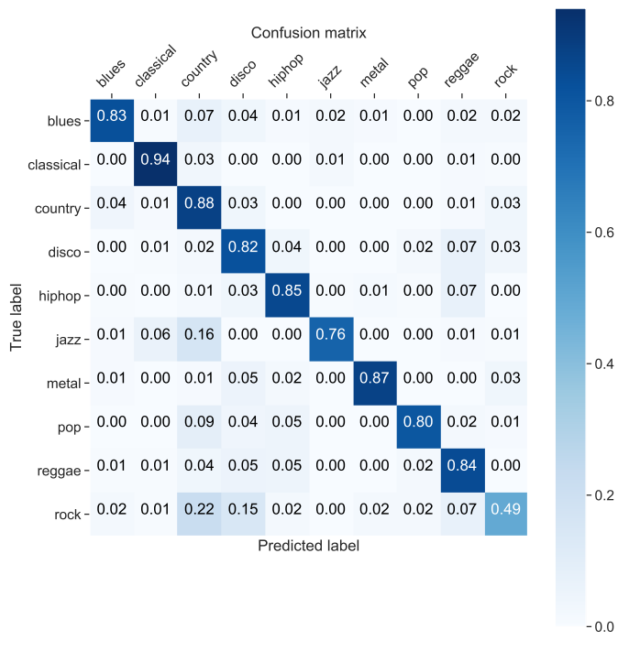
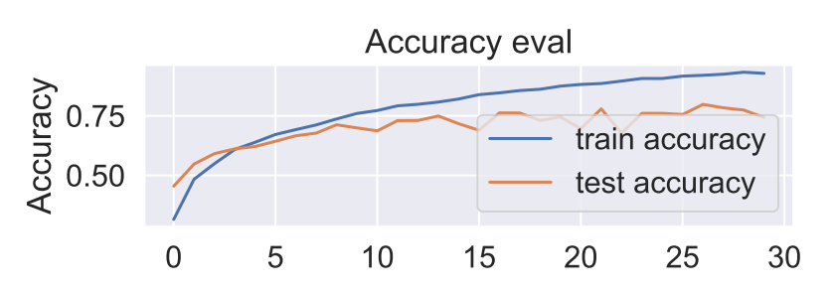
Results
Scores 80.8% on Test data
Classical and metal are easiest to predict
Rock is hardest, mostly mislabeled as country

Slide 6
Outlook
CNN is a good model for classifying music
I don’t think it will get much better, since humans can’t always classify genres perfectly
Would like to keep optimizing more hyperparameters in the CNN
Try to extract intstruments in all the tracks

